Slide 1

Secure network design

Slide 2

What is network security?
According with SANS Institute “Network Security is the process of taking physical and software preventative measures to protect the underlying networking infrastructure from unauthorized access, misuse, malfunction, modification, destruction, or improper disclosure, thereby creating a secure platform for computers, users and programs to perform their permitted critical functions within a secure environment.”

Slide 3

Steps in securing a network
Router Hardening
Switch Hardening
Firewall Setup

Slide 4
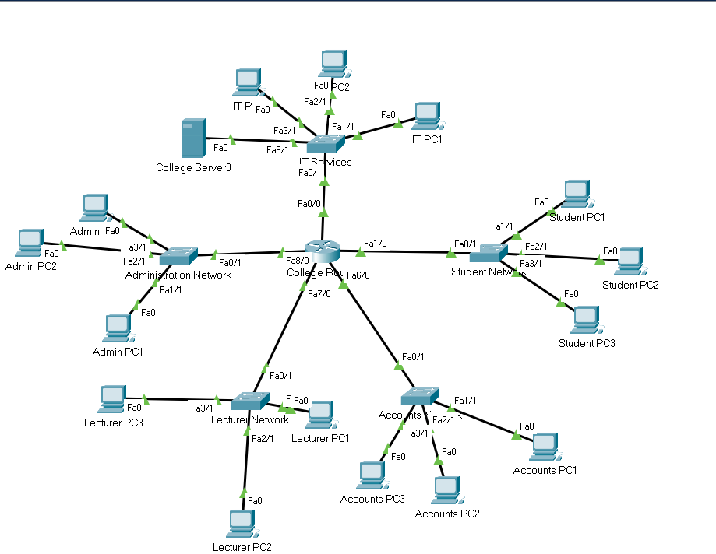
Network design
The network given below is that of a college campus with five major subdomains: Administration Network, Lecturer’s Network, Student’s Network, Account’s Network and IT Services.
Each subdomain consists of a switch connected to three PCs and each switch is connected to the college router.
The connections are made using straight-wired cables
A star-topology has been used for the given network.

Slide 5
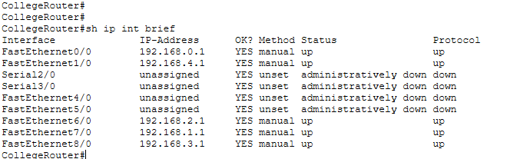
Router hardening
Closure of unused ports: The following commands are used to close unused ports.
config t
int <name of interface>
shutdown
exit
copy run start

Slide 6
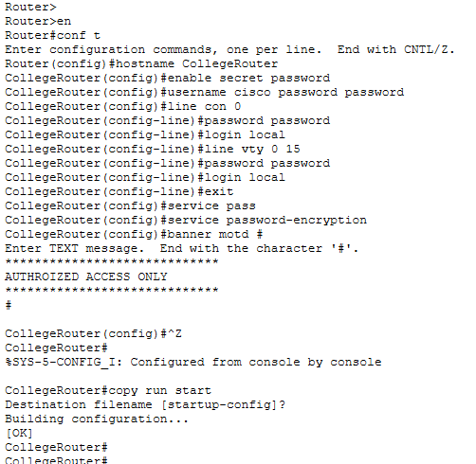
Router hardening
Banner motd: This is not exactly a security feature but it is considered a “good practice”, because it gives the opportunity to display a warning text (banner) when somebody tries to connect to the router or switch through telnet or console connection.
As a next step in a router’s hardening process, should be limiting access to the device using passwords.
Enable password “password”, limits access to the privileged EXEC mode.
Enable secret “password”, limits access to the privileged EXEC mode and the password can be encrypted with this command: “service password-encryption”.
Console password, limits device access using the console connection.
VTY password, limits device access over Telnet.

Slide 7
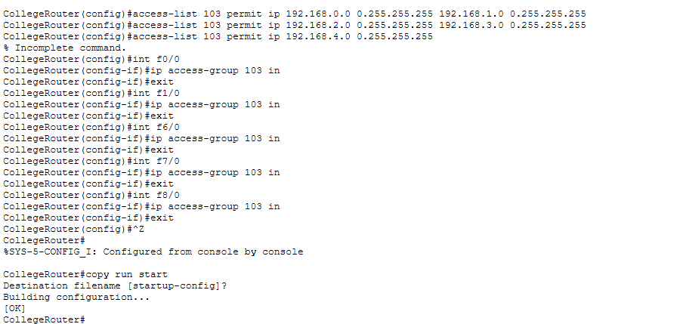
Router hardening
Setting a firewall as shown to allow selected traffic to the router.

Slide 8
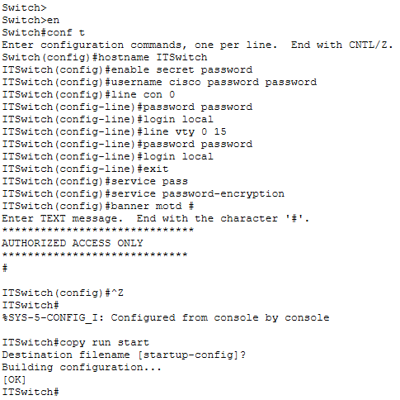
Switch hardening
Setup passwords:
Enable password “password”, limits access to the privileged EXEC mode.
Enable secret “password”, limits access to the privileged EXEC mode and the password can be encrypted with this command: “service password-encryption”.
Console password, limits device access using the console connection.
VTY password, limits device access over Telnet.
Banner motd: This is not exactly a security feature but it is considered a “good practice”, because it gives the opportunity to display a warning text (banner) when somebody tries to connect to the router or switch through telnet or console connection.

Slide 9
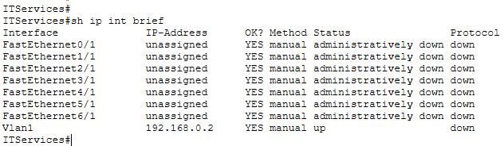
Switch hardening
Closing unused interfaces. For security reasons, it is recommended that all non-used interfaces to be closed. In this way, the area where the switch can be attacked is minimalized. The interfaces are closed manually and the process is quite simple. The commands used are:
Conf t
Int “name of interface”
Shut down
Do copy run start
Exit

Slide 10
Final network

Slide 11

Thank You
Annanya pandey
Student of srmist
Reg no: RA1911030010050

